Slide 1
BYGB 7988 Business Performance Management Risk Analytics
Section 2
Case 2
Instructor: Dr. W “RP” Raghupathi
Prepared By: Regan Alt

Slide 2
Question 1. Given its strategy, what kind of risks does Wellfleet Bank face? Given its new focus on large corporate deals and its need to recruit relationship managers from investment banks, what are the challenges for the risk culture of the organization and its style of risk management in particular?
Strategic Risks:
Wellfleet focuses on large corporate loans, each amounting to nearly $1 billion - if one of these loans defaulted it would deter the entire corporation
Their loan approval process involves a time-consuming “Alpine Pass” approach, where a select few in the Group Credit Committee review hundreds of proposals, delaying growth objectives
Risk Culture at Wellfleet:
They weathered the financial crisis thus far without reporting any losses compared to most other European banks, so there is higher than expected demand from borrowers
Demands for Wellfleet’s expanding loan capacity is putting stress on its risk-management capacity since one wrong decisions could “sink the ship”
Want their risk infrastructure to grow on pace with business opportunities, but primarily operate in emerging world.
Risk management needs to be more efficient if they want to expand in this risky environment competition-, credit-, regulation and product-wise.

Slide 3
(Q1) Can analytics help in assessing the risk? If so, how? Give specific examples of processes/calculations where it would be useful
Yes, Wellfleet can use analytics to mitigate their concerns regarding:
Strategic Risks - return on assets relative to cost of loan and their return on investment relative to expanding their market penetration and capacity
Avoiding some Preventable Risks - adhering to laws/regulations, and ensuring financial security for the bank
How to apply data analytics to quickly and effectively identify:
Strategic risks: using competitive analytics and machine learning (random forest)
Measure: profitability from loan to GCG, GCG’s competitors and if they are underperforming comparatively, GCG’s adaptiveness/innovation to market demands
Preventable risks: using predictive analytics
Measure: GCG’s sales volume volatility, new regulatory requirements in South Africa, accounting irregularities from both parties
Environmental Risks: using natural-language processing or geospatial analysis
Measure: GCG performance, government intervention blocking foreign market penetration, natural disasters, political reform or macroeconomic shifts in lender or borrower country

Slide 4
Question 2. What is your decision regarding the credit proposal at hand? Explain. Discuss
Purpose of Proposal:
GCG accounts for 7% of global gold production - operating in 10 countries (41% profits derived from South Africa)
They are restructuring with a new management team who wants to regain $800 million in losses from failed hedge - needs $1 billion to continue financing its projects and other growth initiatives
Drawbacks of Proposal:
GCG’s profits are based on the price of gold, and the loan was proposed at the beginning of the global financial crisis where the price of gold was already showing signs of volatility
Many broader issues such as: increasing mining costs and reputational/political risk that would make the $1 billion loan too risky even for Wellfleet
GCG total debt was 800% in 2007, up from 200% in 2006 and has the highest Expected Default Frequency according to peer analysis
Conclusion: Do not loan to Gatwick Gold Corporation

Slide 5
(Q2) Discuss the role of analytics in arriving at this decision
Using analytics and business performance measurements to make loan decision:
Predictive Analytics: To query data from government statistics to forecast the increasing political risk, and inflating mining operating costs in sub-Saharan Africa, and volatility of price of gold
Text Analytics: Natural language processing algorithms to derive insights on weakening market demand for gold jewelry from customer rating websites and social media
Geospatial Analytics: Combining internal/external data by overlaying external map data on top of GCG’s mining operations to uncover a map of lower gold profits and demand by country
Risk Analytics: Developing Machine learning algorithms to see GCG’s sensitivity to gold price volatility in real time, to forecast future profit margins that are likely not sufficient to cover cost of loan
Wellfleet’s Risk Management team already has a backlog of credit applications to analyze for growth opportunities alongside the global economic downturn, making GCG’s loan unattractive

Slide 6
Question 3. Review the Expected Loss, Economic Revenue, and Economic Profit calculations for the proposal. What strikes you about the nature of risk quantification?
Nature of Risk Quantification:
The Risk Adjusted Revenue - the example of lending in the Netherlands instead of the UK shows a lower Expected Revenue, so presumably loaning to South Africa would lessen it even more
Economic Profit - taking into account the Risk-Adjusted Revenue and the profits after tax, Wellfleet’s profit is lowered to just a fraction of the Total Revenue
These risk quantification calculations do not take into account inflation or the political, economic, or cultural environment of the potential client’s country
The equations appear based on a company’s last quarterly or yearly-reported profits, not adjusted for real-time
Risk-adjusted performance metrics do not take into account industry-specific metrics such as competition, market demand, operating costs, or diversification in supply

Slide 7
(Q3) What types of analytics can help in these calculations?
How Risk Analytics can strategically improve risk quantification:
Can bridge the gap between corporate and risk management teams using internal and external data to improve Economic Revenue calculation
Reducing risk costs: improved data cleanliness and using combined risk scores of customer segments to select the loans with the least Expected Losses
Improve risk monitoring in real time and uncover early warning signs from borrower company and country
Use risk models to predict the behavior of past-due borrowers and then strategize the most productive collection intervention
Prescriptive analytics:
Can provide an enterprise-wide approach using past insights from similar loans and current market metrics to more accurately measure Economic Profit
Calculating Risk-Adjusted Revenue in real time with more environmental factors can help meet the demand of Wellfleet’s lending power due to improved customer preselection

Slide 8
Question 4. Analyze the risk management process at Wellfleet Bank. What suggestions might you make to the CEO about improving the process?
Wellfleet Risk Management Process:
Has a hierarchical, time-consuming approval process known as the “Alpine Pass” which deters potential clients and hinders corporate banking growth objectives
They compartmentalize and manage market, operational, reputational, and country risks separately when each proposal should be holistically analyzed
Suggestions:
Implement AI and machine learning to improve efficiency and accuracy of credit risks and reduce lending costs while still relying on human approval from the top of the Group Risk Committee
Improve cooperation between corporate banking and risk management teams in order to weather the global financial crisis
Continue to use Investment Banking managers to participate in syndicated or leveraged loans to increase capacity lending at a higher risk, generating more returns

Slide 9
(Q4) Analytics has the potential to significantly assist with risk management. Describe this role
How data can improve Wellfleet’s risk management:
Using all the available data and normalizing it based on their regions of concern, managers can create a holistic risk score faster than the competition, mitigating the “Alpine Pass” hurdle
This method can improve responsiveness and increase loan volume due to faster approval process
Machine learning tools can track proposed regulation as it passes into law, and synthesis the relevant text so the corporate and risk management teams can coordinate decisions and strategize from it
Predictive analytics can identify/assess risks that impact Wellfleet’s growth strategy, allowing them to reduce losses and take advantage of profits (through IB syndicating/leveraging loans)
Adopting analytical tools can clarify risk ownership processes, improve transparency with key stakeholders and decision-makers, and align risk objectives with business strategy

Slide 10
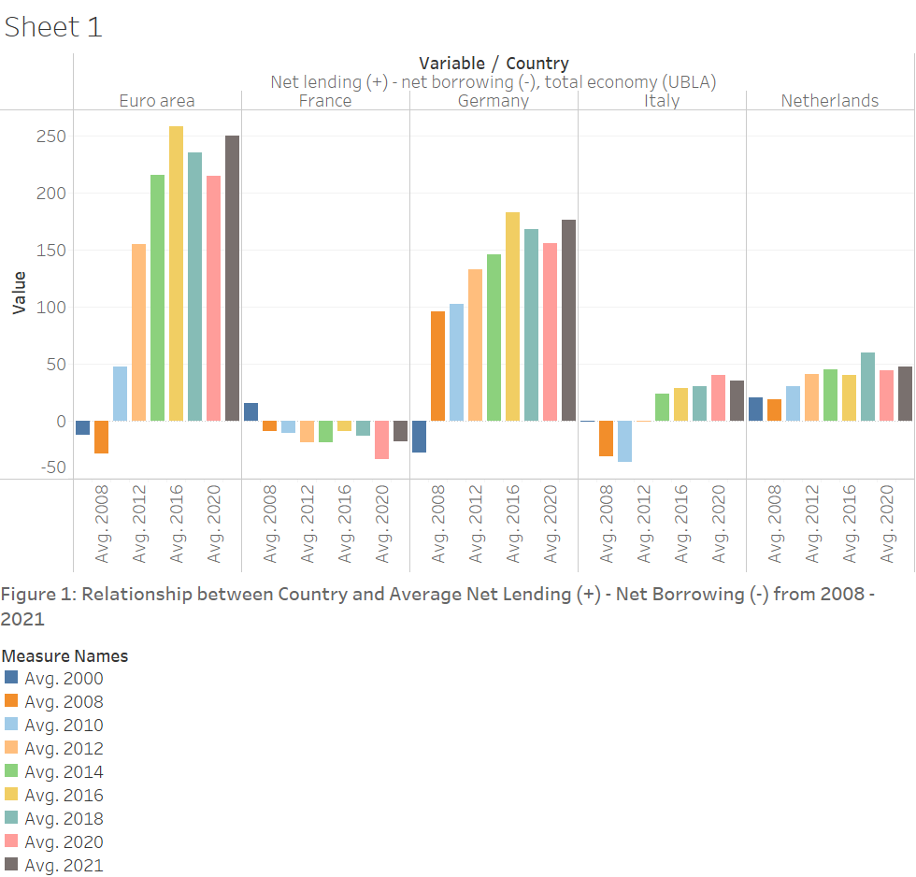
Insight 1: Country vs Average Net Lending
Question 5. Develop 3 insight charts for Wellfleet to make informed decisions
The chart shows the variability between average value of each region’s net lending minus their net borrowing as part of their total economy from 2008 to 2020.
The insights derived from this chart show how the Euro Area as a whole and Germany, who are historically significant lenders, both had major downturns at the beginning of the 2008 global financial crisis.
This chart only covers the EU and European area who have strong economies and rebounded by 2012. Since Wellfleet works in emerging markets and was considering lending $1 billion to GCG in 2008, it would be advised not to lend at this time due to risk of defaulting.

Slide 11
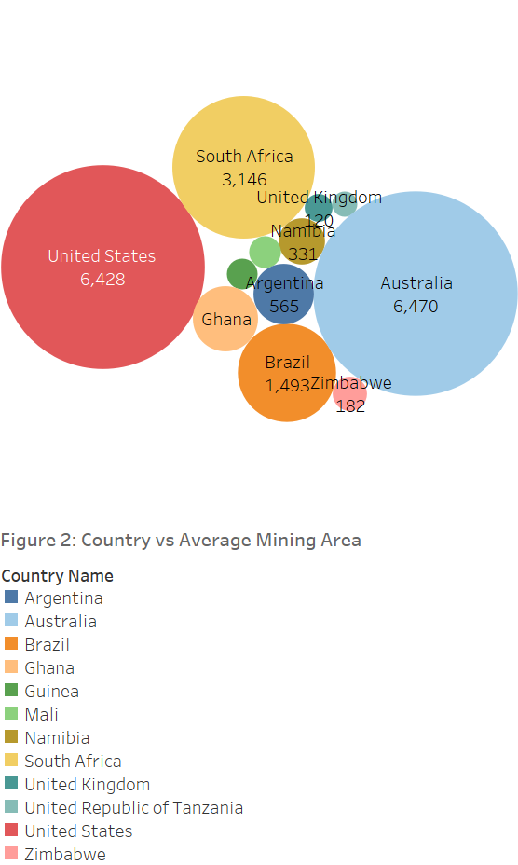
Insight 2: Country vs Average Mining Area
(Q5)
This chart shows the correlation between countries where GCG has gold mining operations and the average mining area within each country.
The size of the mining area as a whole within each country is represented by the size of the bubble, and thus it is evident the three countries with the largest mining capacities are Australia, South Africa, and the USA.
Although GCG operates in three of the countries with the highest potential for gold mining, 41% of its revenue comes from South Africa. The diversity in their location but not of mined-goods causes them to rely heavily on one country. Wellfleet could use this insight to highlight the riskiness of the loan if the price of gold were to drop significantly in a short time.

Slide 12
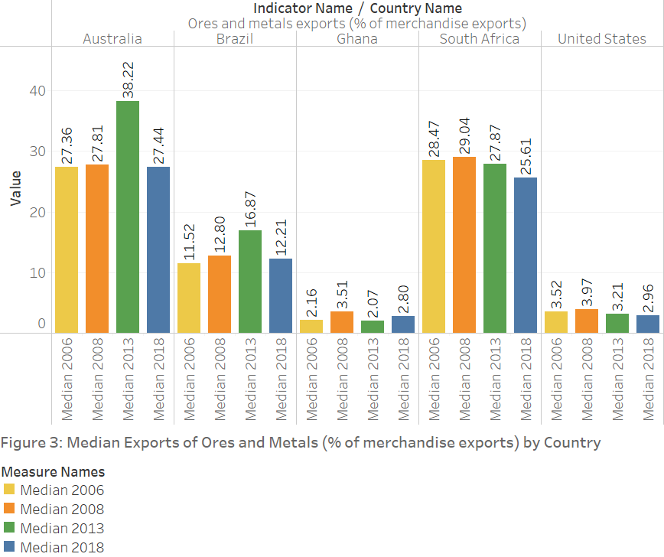
Insight 3: Exports of Ores and Metals
by Country
(Q5)
This chart shows the median amount of ore and metal exports as a percent of total merchandise exports, associated with a country GCG operates in.
The insights derived from this comparative bar chart suggest the amount of ores and metals exports are steadily decreasing over time in each country.
South Africa in particular is experiencing the most constant decline in ores and metals exports between 2006 to 2018. Wellfleet could use predictive analytics to measure demand for ores and metals in the next decade, alongside GCG’s heavy reliance on mining in South Africa to determine the loan is too risky to pursue.

Slide 13
(Q5) Interpret the results. Provide insight to make informed decisions at Wellfleet
Based on this analysis and due to the looming global financial crisis threatening not only the European economy but markets all over the emerging world, Wellfleet pursuing this $1 billion loan with GCG in 2008 is not recommended at this time, even if it is syndicated or leveraged.
Additionally, Wellfleet can emphasize GCG’s homogenous reliance on South Africa’s mining capacity as their main revenue stream as a major risk factor for WellFleet’s enterprise alone. On top of their dependence on the volatile price of gold and other environmental factors such as political risk, and inflating prices of mining operations is enough to suggest to GCG to invest in their mining facilities in Australia of the United States where markets are more stable.
Overall, although this is a loan where the risk is high and the return is potentially even higher, due to the impending global crisis, the downward trend of ore and metal exports from most countries, and GCG’s already high vulnerability to gold prices renders the loan too risky to pursue. Wellfleet can try to establish a relationship with GCG at this time, however, by helping them restructure their debt and diversify their revenue streams. Wellfleet can also pursue other loans in emerging markets who are more structurally diversified.
Country Net Borrowing/Lending data source: https://dashboard.tech.ec.europa.eu/qs_digit_dashboard_mt/public/sense/app/667e9fba-eea7-4d17-abf0-ef20f6994336/sheet/2f9f3ab7-09e9-4665-92d1-de9ead91fac7/state/analysis
Country vs mining area data source: https://doi.pangaea.de/10.1594/PANGAEA.910894
Country vs ore and metal exports data source: https://data.worldbank.org/indicator/TX.VAL.MMTL.ZS.UN?end=2020&start=2005

